Slide 1
INVESTMENT CASE STUDY SUBMISSION
Submitted by,
Vishwas P G

Slide 2
Objectives
• To support Spark Funds to understand the Global trends in investments between 5 to 15 Million
• To identify the best sectors, countries, and the most suitable investment type.
• To identify the total investments in top English Speaking countries.
• Identify best investment type like venture, seed, private equity, angel etc. suitable for investment.
• Provide information about the best sectors having high investment potential under top 3 countries

Slide 3
Problem solving methodology
Import Data files using proper encoding scheme
Cleaning the data to remove special characters and wrong values
Merging the dataframes to create a master dataframe
Cleaning the data by removing null values
Obtain the top 9 countries for investment under venture funding type
Obtaining the dataframe for top 3 English speaking countries and merging with mapping file
Mapping the primary sectors to the main sectors and creating the final dataframe for analysis
Obtain the top 3 sectors for the top 3 countries based on count of invested sectors
Plot for various checkpoints and total investment values for top 3 sectors

Slide 4
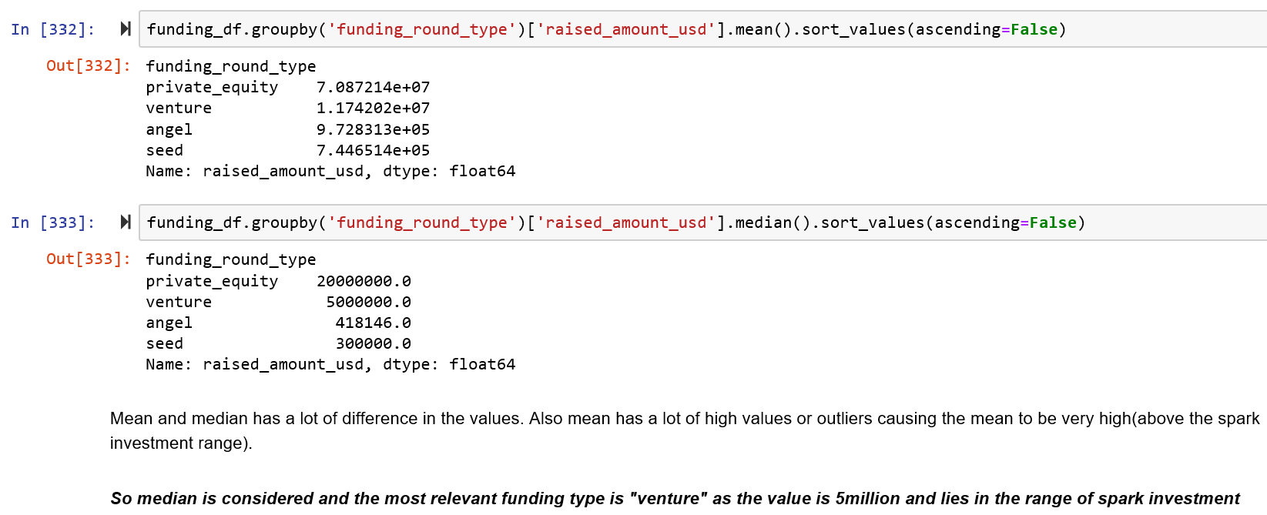
Funding type Analysis
Master dataframe is obtained after cleaning and merging the two dataframes of companies and rounds
The master frame is cleaned to remove the null values and this is analysed for the funding types – venture, angel, private equity and seed
Median is found to be the most representative value of the investment amount
Using the median values it is found that ‘Venture’ is the most suitable funding round type for Sparks fund investment

Slide 5
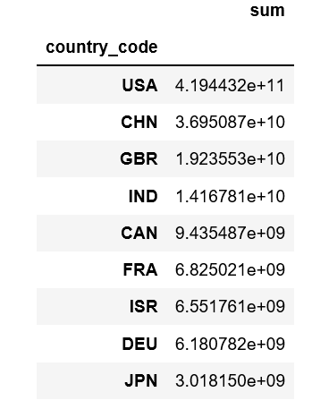
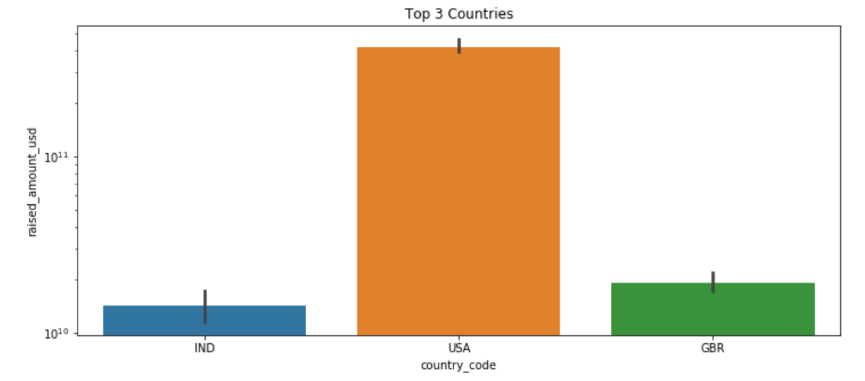
Country Analysis
The dataframe is grouped based on country codes and the sum of total investment is obtained
This gives us the top 9 countries which have received the highest total investment
Based on the given data the top 3 English speaking countries are found to be USA, GBR and IND
These are the most suited investment friendly countries for Sparks investment

Slide 6
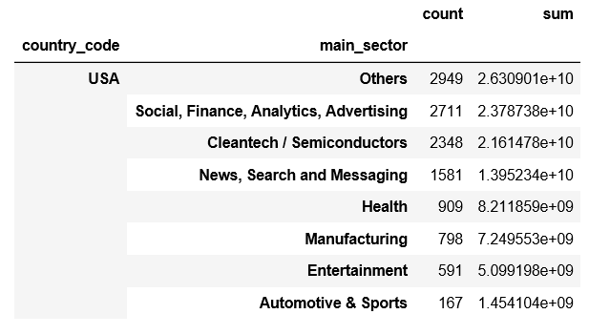
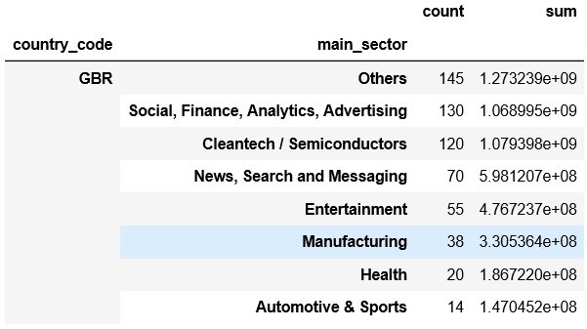
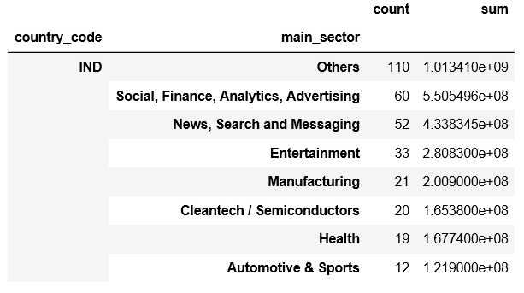
Sector Analysis
The dataframe containing the top 3 countries and the mappings file are merged to provide the sector dataframe
The primary sectors are extracted and are mapped to one of the 8 main sectors
They are then filtered as per the Spark fund requirement for investment between 5-15 million USD
Individual dataframes for the top 3 countries are filtered out
The top 3 sectors for each country is then obtained. The top 3 sectors are - 'Others', 'Social, Finance, Analytics, Advertising' and 'Cleantech / Semiconductors'

Slide 7
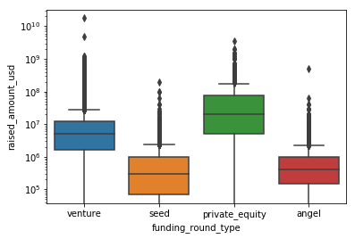
Results
Plot showing the Funding round type vs Raised amount(USD) for the 4 main funding types

Slide 8
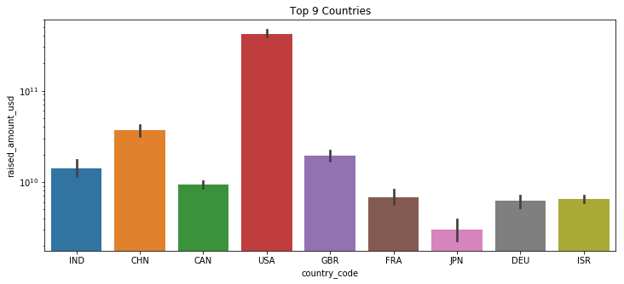
Results
Plot showing the country code vs raised amount(USD) for the top 9 countries.
It can be clearly seen that the top 3 countries are USA, China and Great Britain.
However China doesn’t have English as its official language. So the top 3 English speaking countries are USA, GBR and India

Slide 9
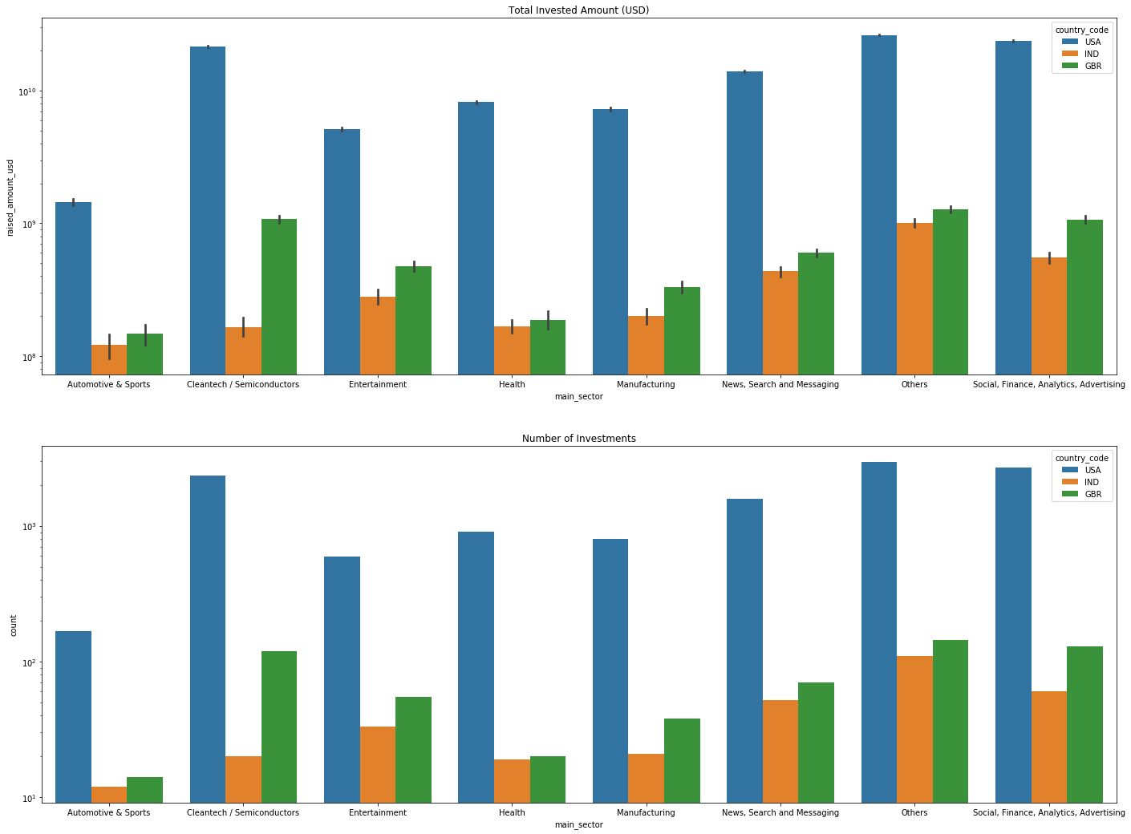
Results
Plot showing the log scaled values of Number of Investment and Total Amount Invested for the Top 3 countries in the Main Sectors

Slide 10
Conclusions
The most suitable funding type for Sparks Fund for an investment between 5mn to 15mn is in ‘Venture’ funding type
The top 3 English speaking countries for investment are USA, GBR and IND
The top 3 sectors for investment for the 3 countries are
Country | Sectors
USA | Others Social, Finance, Analytics, Advertising Cleantech / Semiconductors
GBR | Others Social, Finance, Analytics, Advertising Cleantech / Semiconductors
IND | Others Social, Finance, Analytics, Advertising 'News, Search and Messaging

